Slide 1
Deep content-based music recommendation
A¨aron van den Oord, Sander Dieleman, Benjamin Schrauwen
(NIPS 2013)

Slide 2

Collaborative filtering
Make automatic predictions about the interests of a user by collecting preferences or taste information from many other users (collaboration).
Assumption: those who agreed in the past tend to agree again in the future.
Notes:
The underlying idea of this approach is that many collaborative filtering models work by projecting both the listeners and the songs into a shared low-dimensional latent space. The position of a song in this space encodes all kinds of information that affects listening preferences. If two songs are close together in this space, they are probably similar. If a song is close to a user, it is probably a good recommendation for that user (provided that they haven’t heard it yet). If we can predict the position of a song in this space from audio, we can recommend it to the right audience without having to rely on historical usage data.

Slide 3
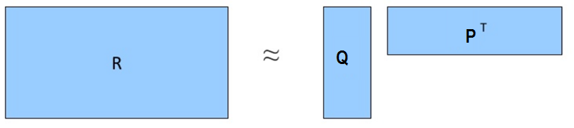
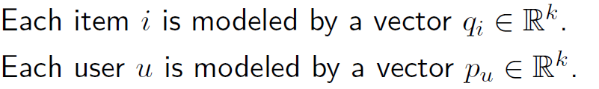

Collaborative filtering Using Latent Factor Model

Slide 4
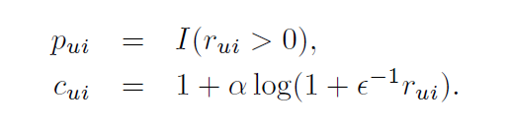
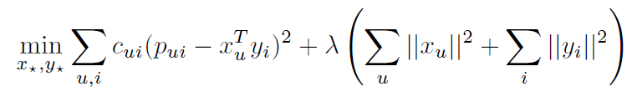
collaborative filtering model

Slide 5

cold-start problem
Songs with few rations or no ratings at all will not be recommended
Predict the latent factor from using music audio using CNN

Slide 6
Latent factors prediction
A regression problem
Using as ground truth the latent factors calculated with WMF for available usage data.
Input: mel-spectrograms - time-frequency representation that is obtained from an audio signal by computing the Fourier transforms of short, overlapping windows

Slide 7
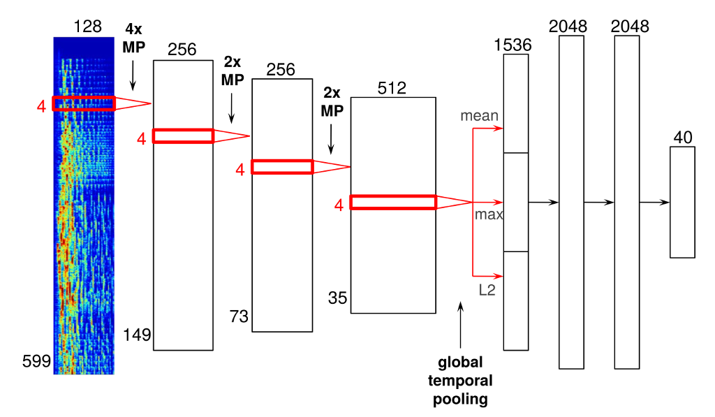
Architecture

Slide 8
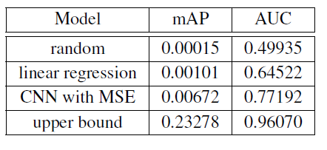
Results

Slide 9
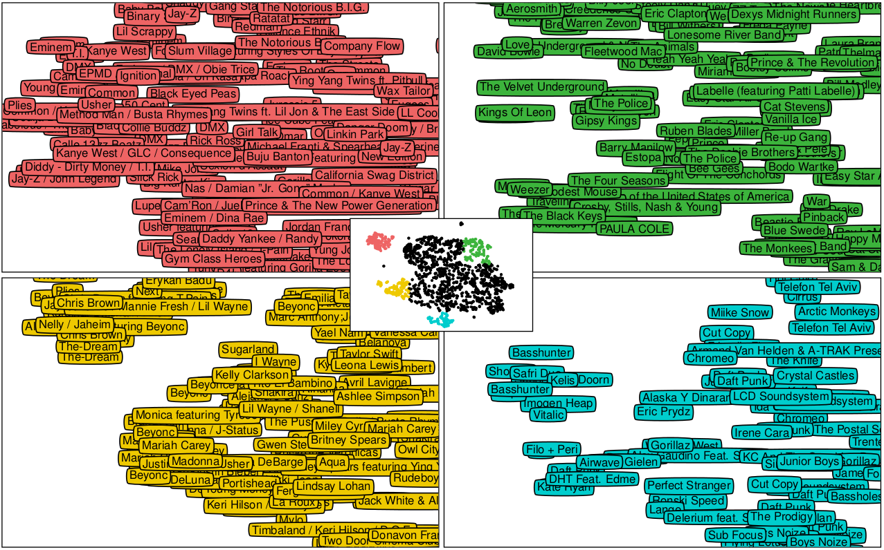
Can’t do without some semantics
Notes:
No knowledge about the content, still, the vector representation encapsulates semantic knowledge about the song.

